Slide 1
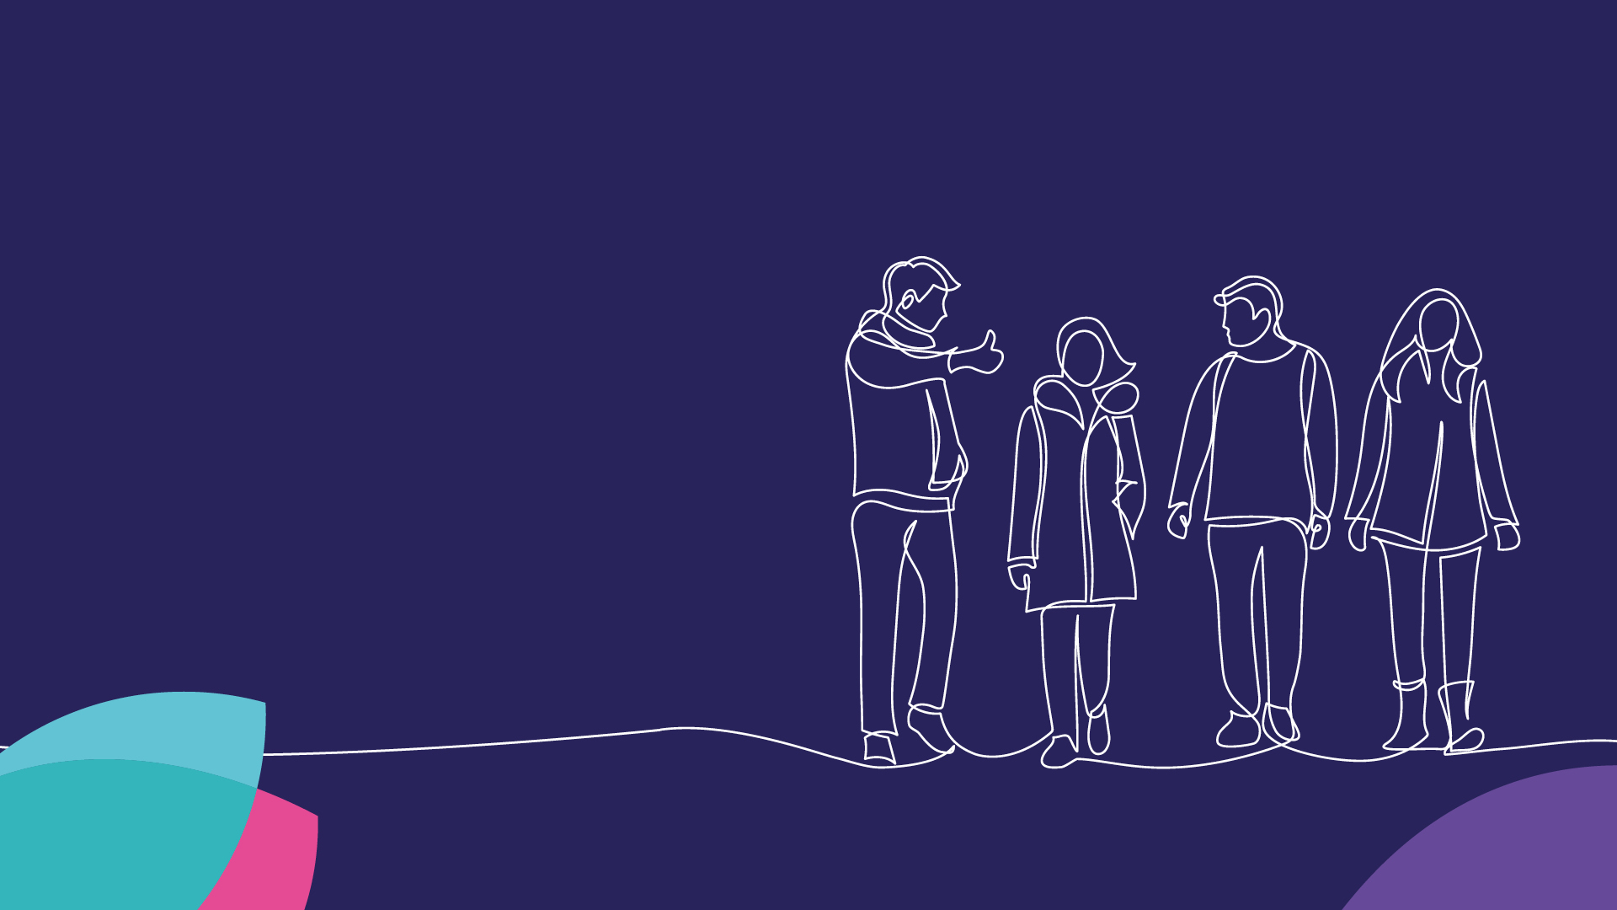
Our Life Story Approach
Family Networks are part of everyone’s Norfolk Story
Practice Week
Tuesday 21 November 2023
Lizzie Hills

Slide 2


Welcome
Welcome!
Please be aware that some of the sessions are being recorded for sharing later.
We want people to participate but please use the ‘raise hand’ facility to ask questions and contribute when others are talking.
Please be considerate to others - together we want to create a safe, open and reflective space to learn.
You can turn on live captions on by clicking on the 3 dots at the top of your screen if you need this.
The link to the feedback form will be put in the chat.
Please do take the time to complete it after the session.
Thank you!

Slide 3
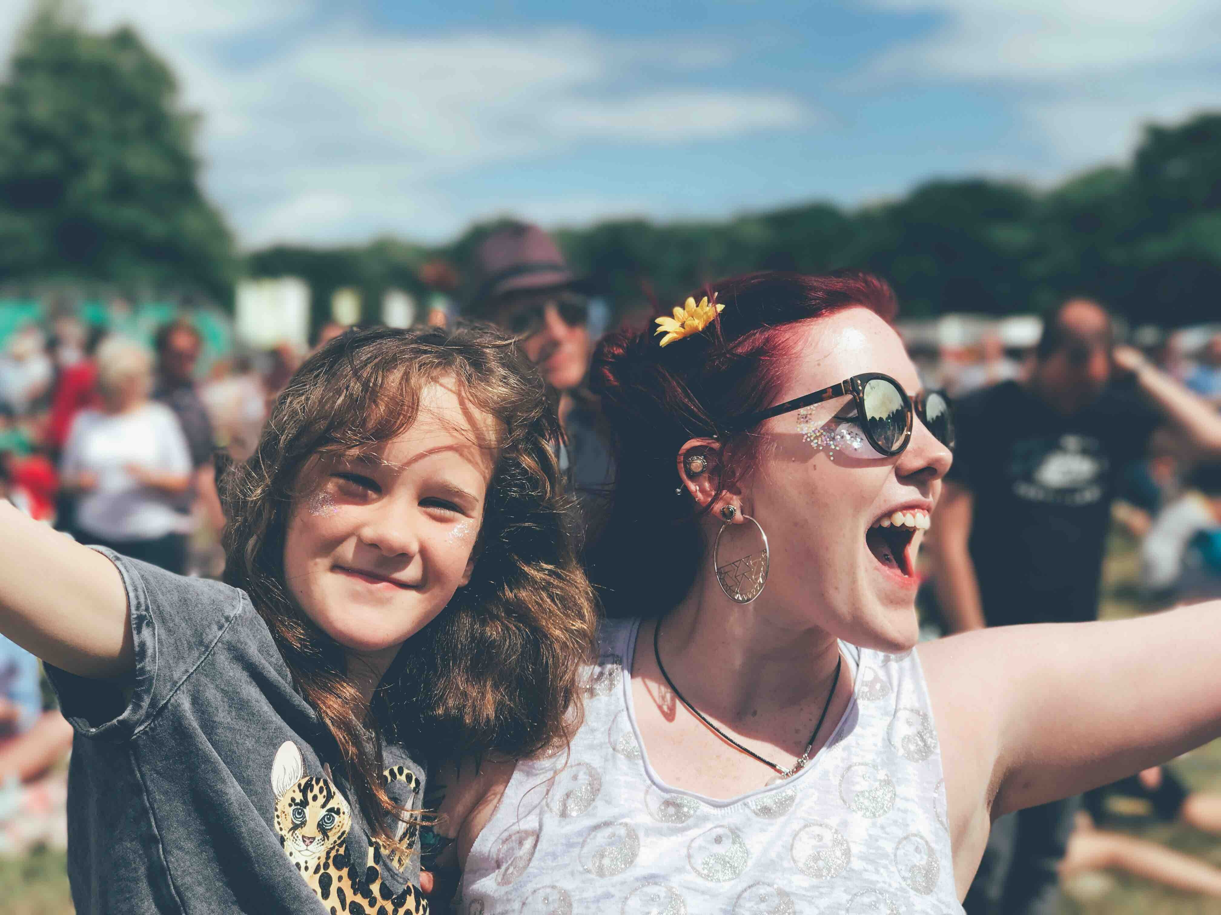


“We are all a collection of stories, the ones other people tell us and the stories we tell ourselves, these shape who we are”
Richard Rose

Slide 4

My Norfolk Story
All about me
Difficult times
Experience before and after care
Therapeutic life story work
After being in care
Explaining intervention to children
Intervention and sense making
Life story work with Looked after Children
Therapeutic work and planned intervention
Support for former Looked after Children

Slide 5

Principles behind My Norfolk Story
Life story work is routine, at all levels, at all points of contact, ongoing not a one off
Children and young people play an active role in the process of understanding their experiences and history. We carry out clear, honest, sensitive life story work at all important moments in a child or young person’s journey with us.
We find a safe and supportive way to understand the past, make sense of the present, and then revisit to shape the future
A life story approach involves everyone in children’s lives.
Children and young people have a tangible record of their story, their experiences and our interventions, for them to hold and own, and revisit in the future.
Life story work is embedded in and aligned to our ways of working – we follow a Family Networking approach to create a shared narrative with parents/carers – we use appreciative inquiry to explore what experiences mean, not just facts

Slide 6
What does a life story approach look like?
All the time - time to help children and young people understand what is happening is before and during not just after
Reframing life stories to “all about me”
Children and young people need to hear information in instalments
Children and young people should control the timing, pace and direction
Different perspectives are sought and heard to really shape understanding, accept uncertainties, and form a coherent narrative
Using digital approaches to meet children and young people where they are
Reviews are a key moment to revisit what a child understands and what everyone is saying to them

Slide 7
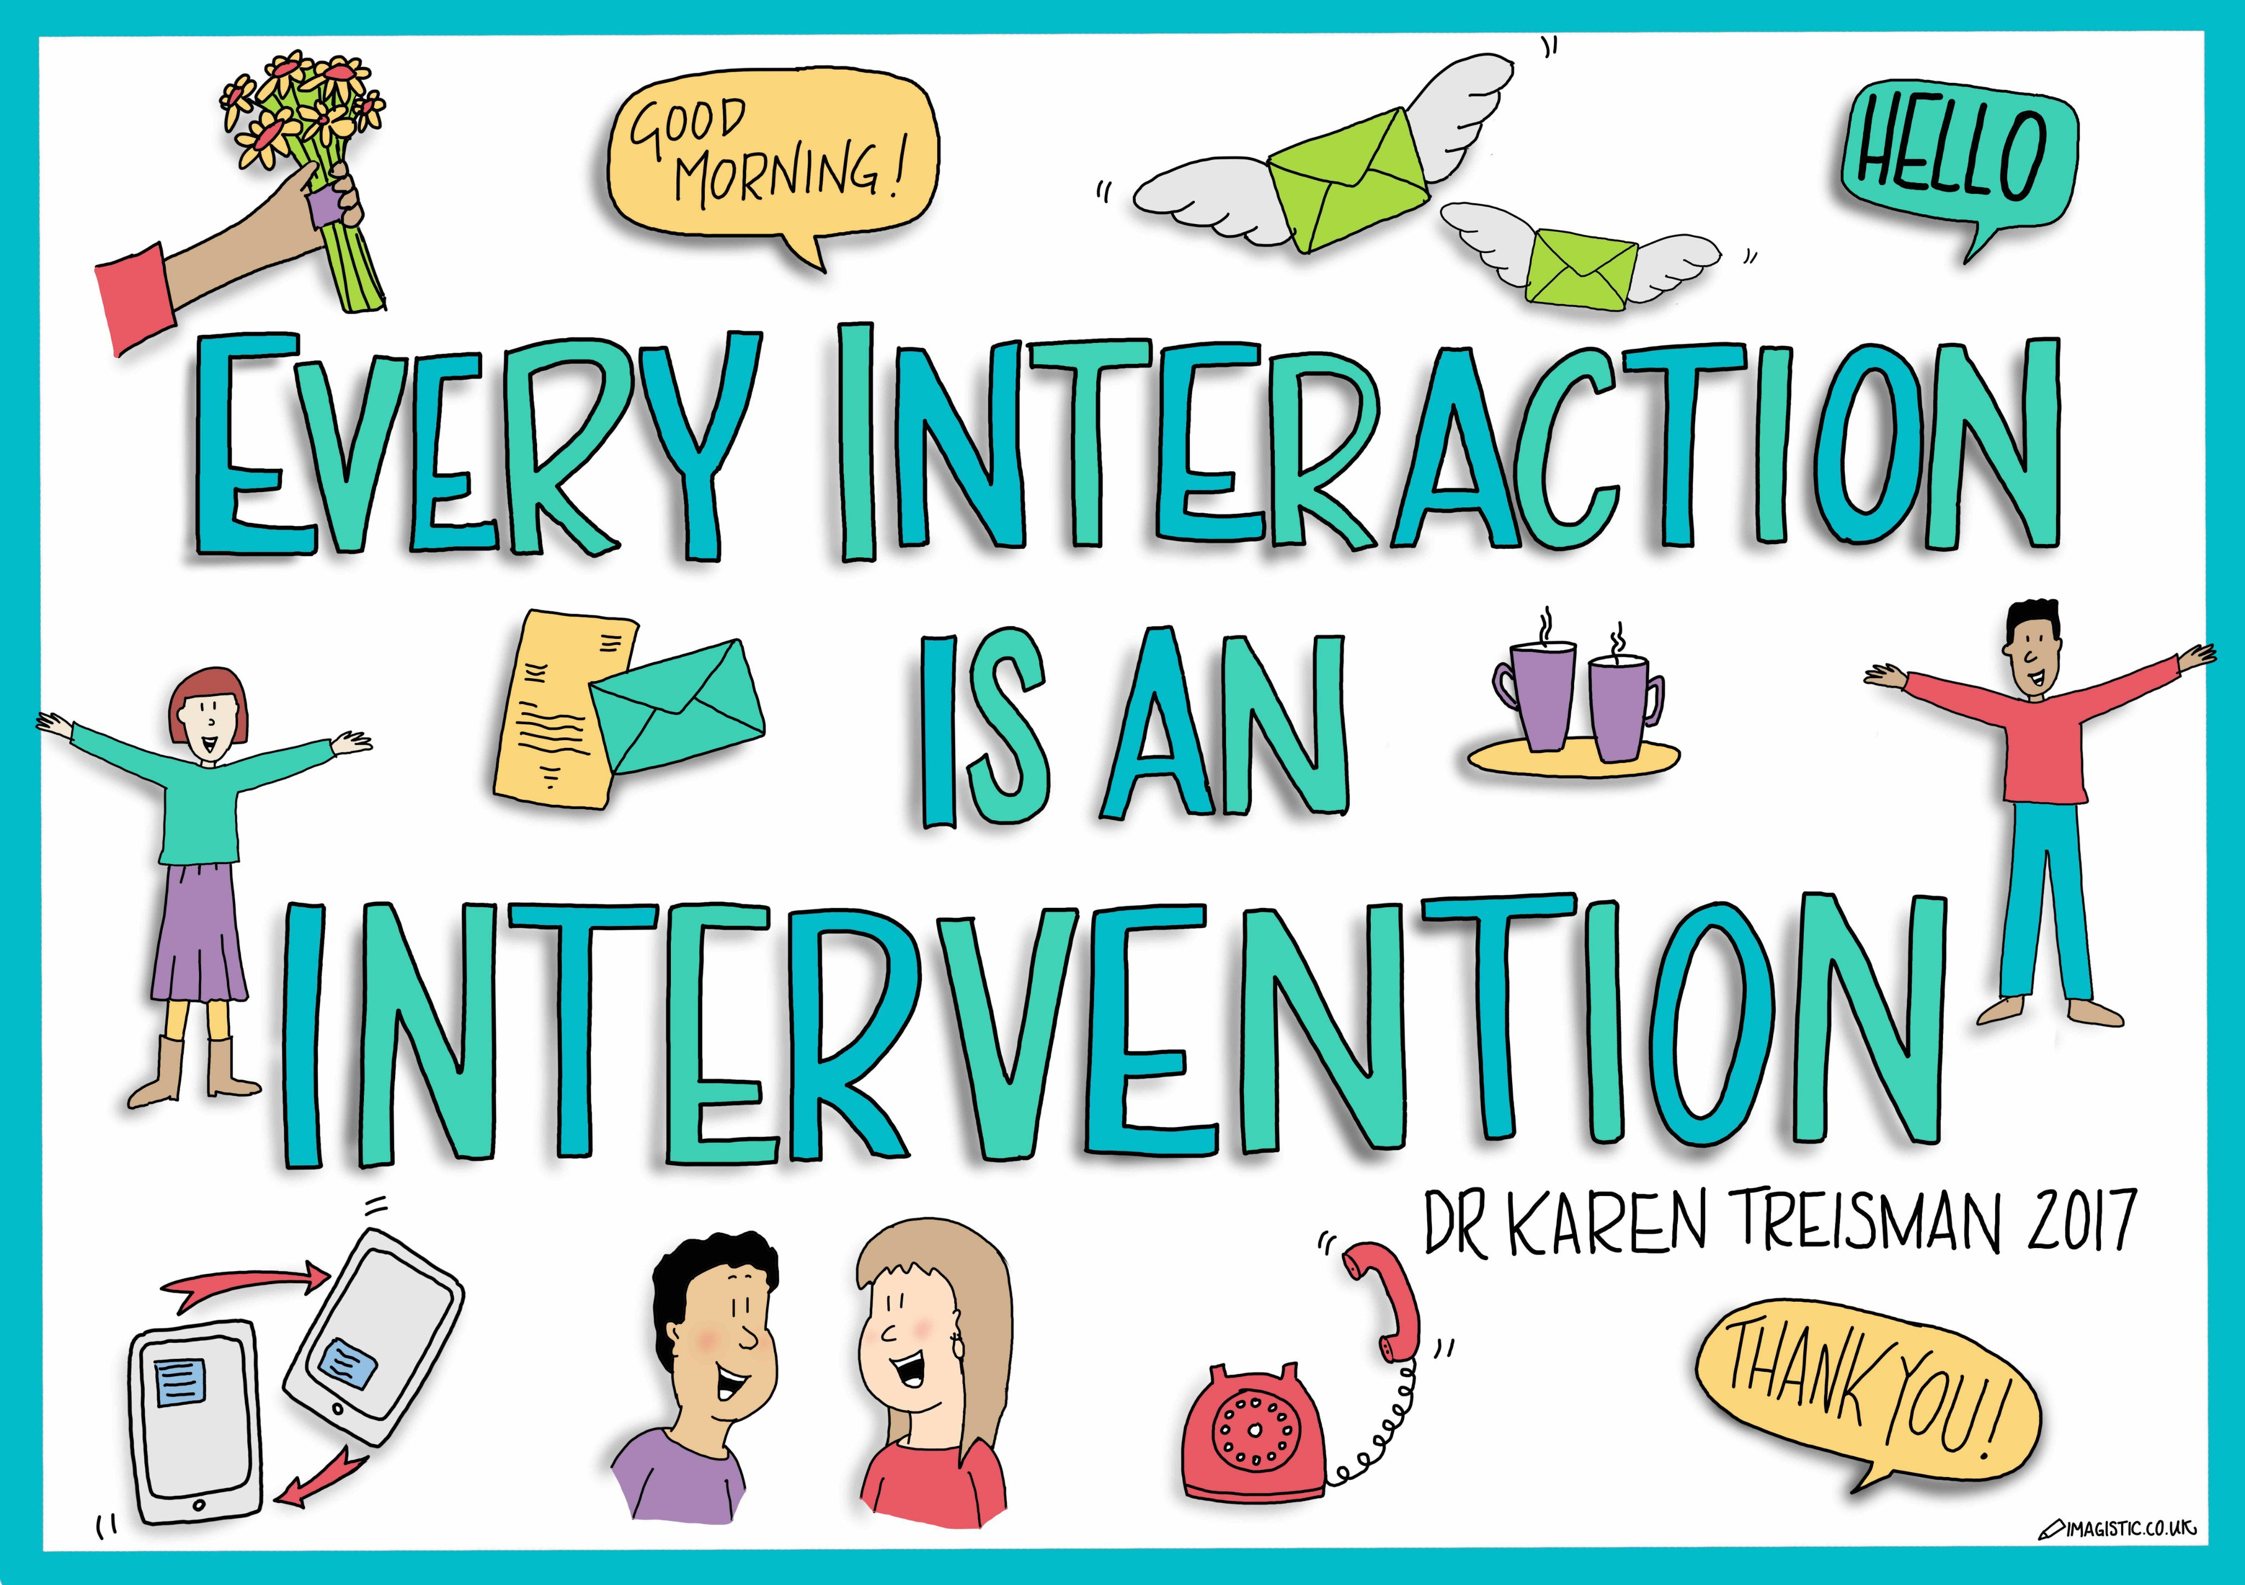
Ever action is an intervention

Slide 8
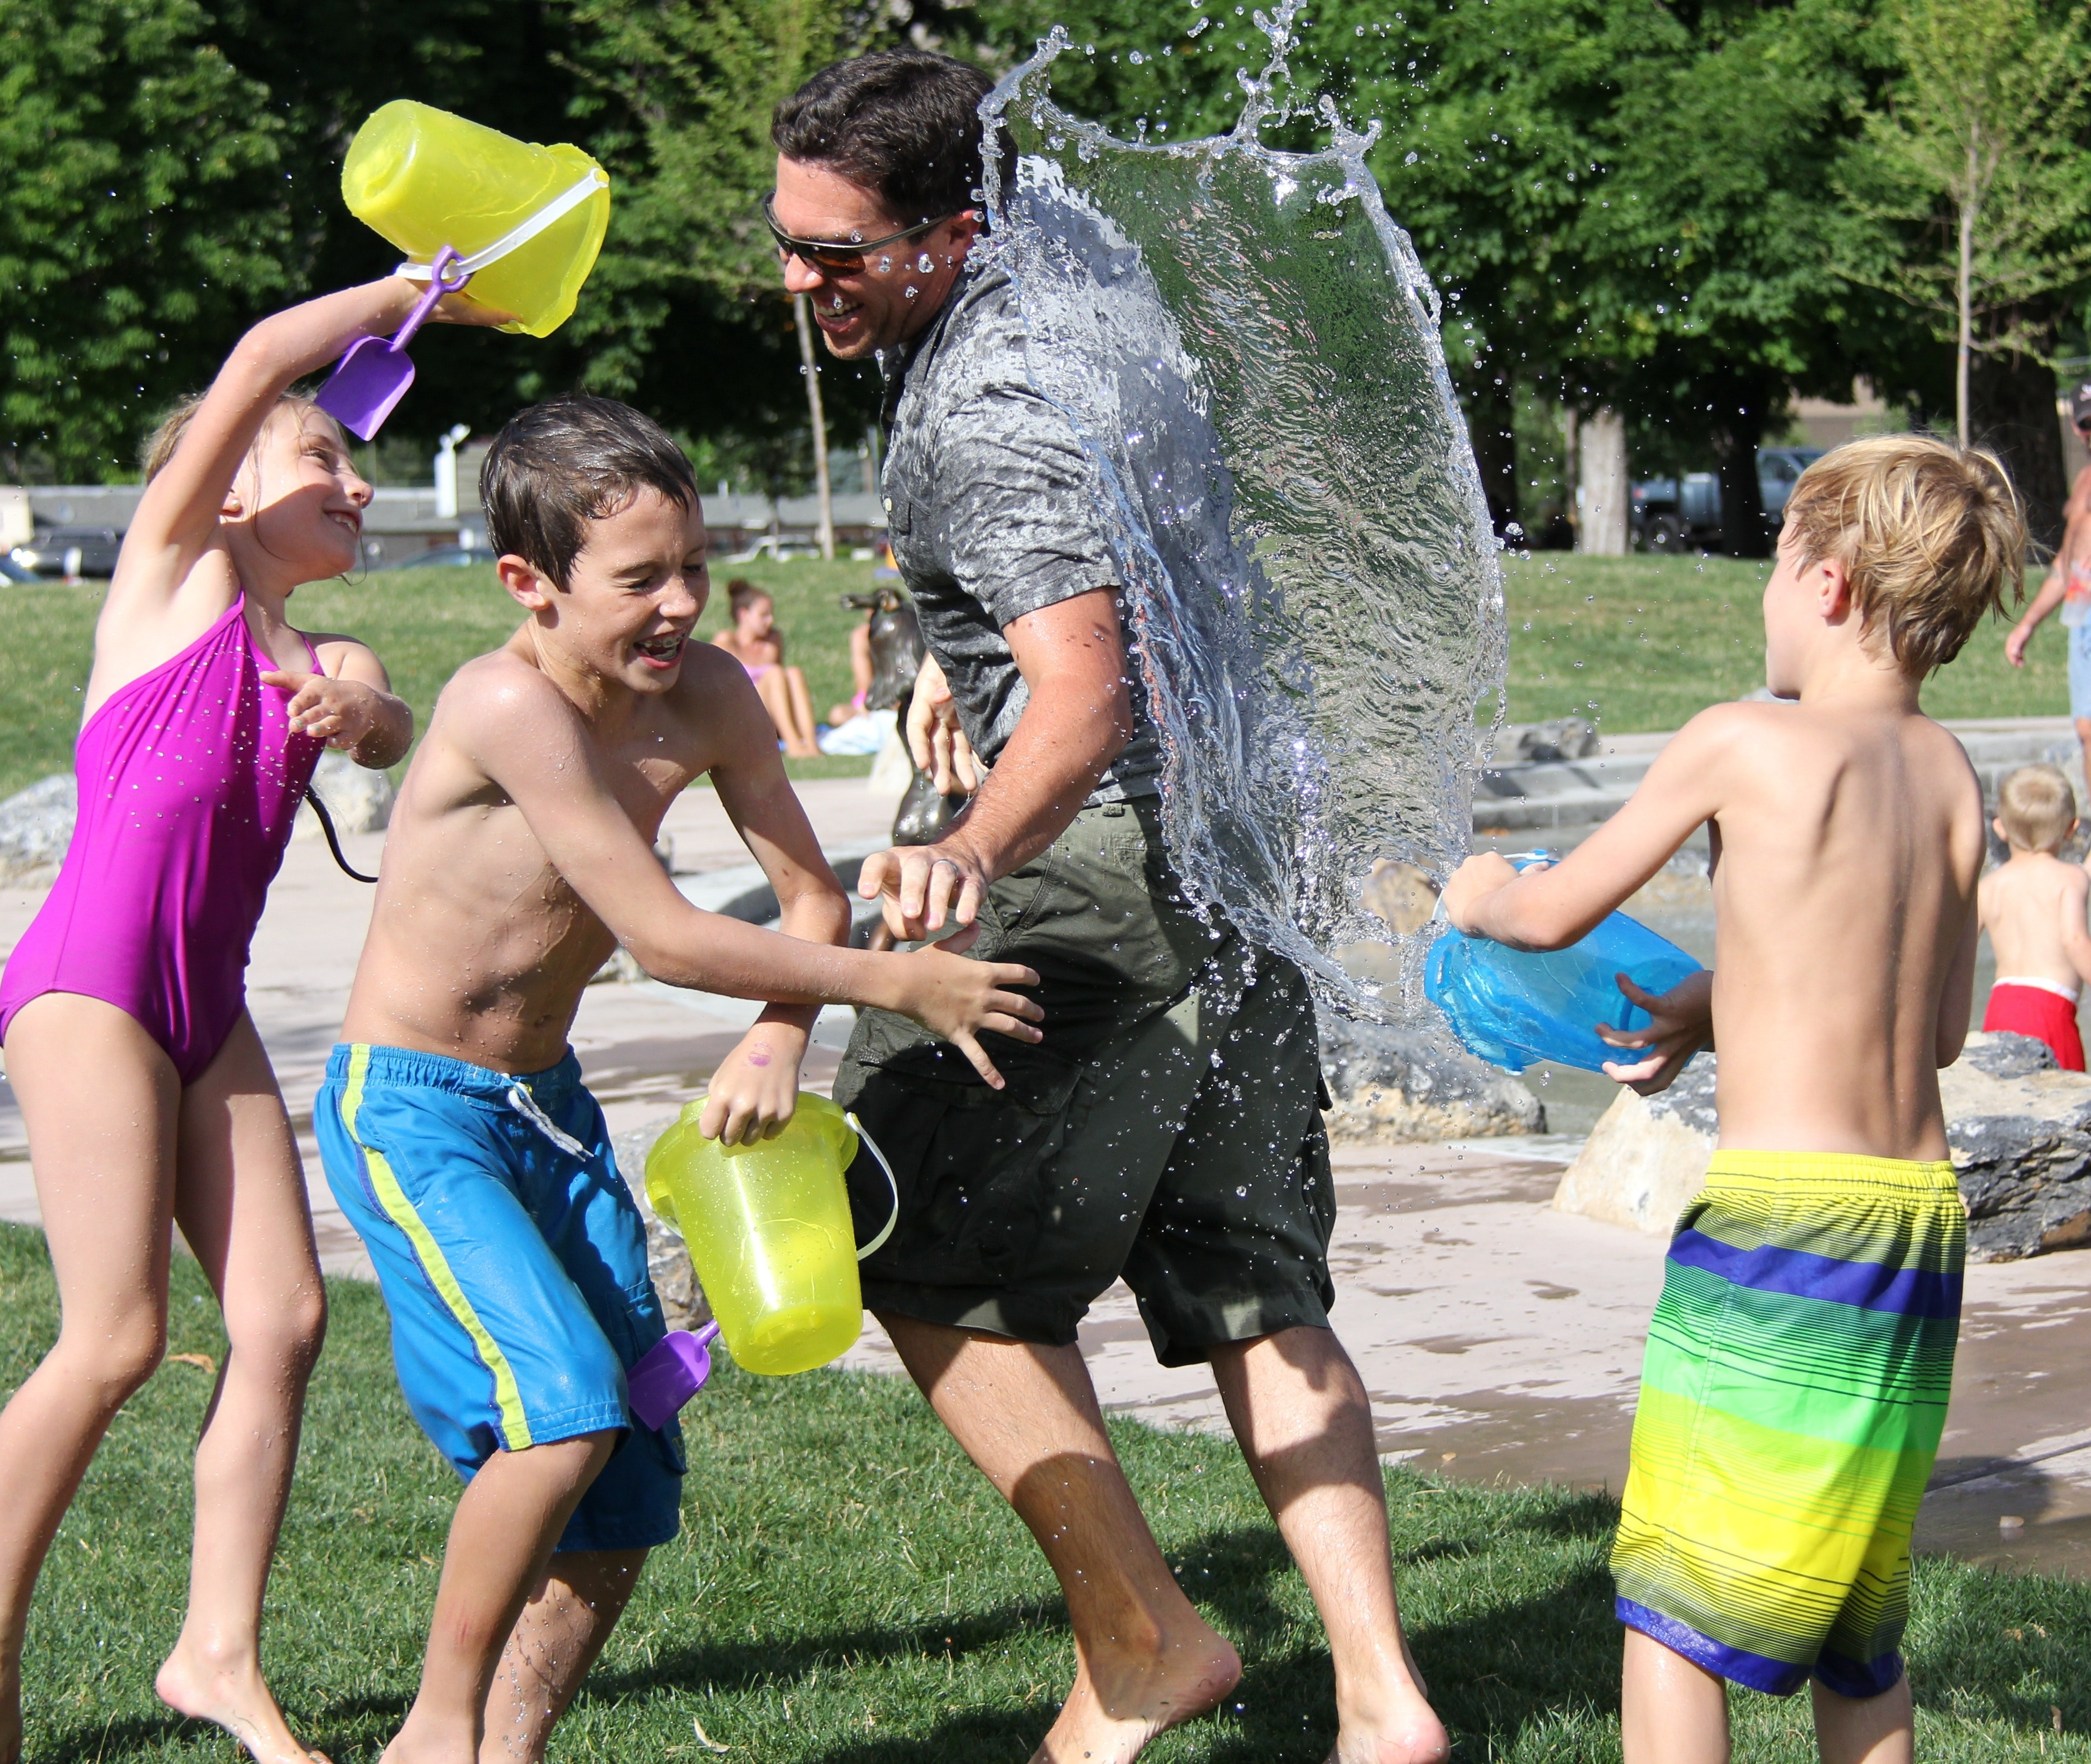
Life work is storytelling
“At its heart, life work is storytelling. It’s about helping children to know and to understand their personal stories and the life experiences that have shaped them.”
Rees 2018: 83

Slide 9

Whose Story?
Everyone in a child or young person’s network can either reveal part of the story, or support the child to understand

Slide 10

LUUUTT Model

Slide 11
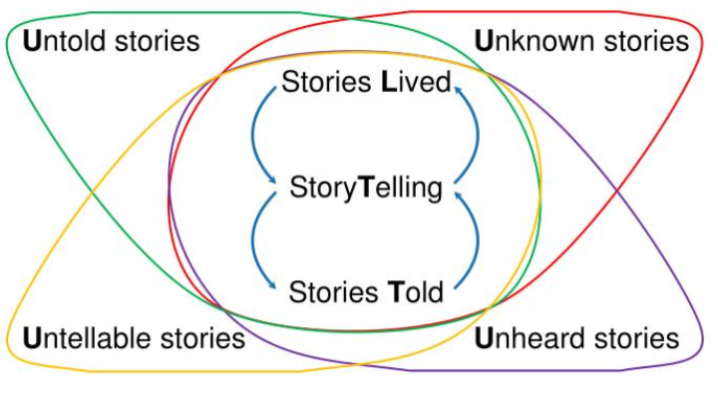
Storytelling
Stories Lived are the actions of our lives which cannot be changed, what we actually did or are doing
Story Telling thinks about the way in which people tell their stories.
Stories Told refers to what we say we are doing, the meaning we make of these stories, which informs what we do next.
Stories Untold, Unknown, Unheard and Untellable may not be conscious or visible.

Slide 12

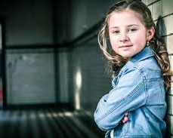

What are the barriers to parents and family members telling the stories of their lives?

Slide 13
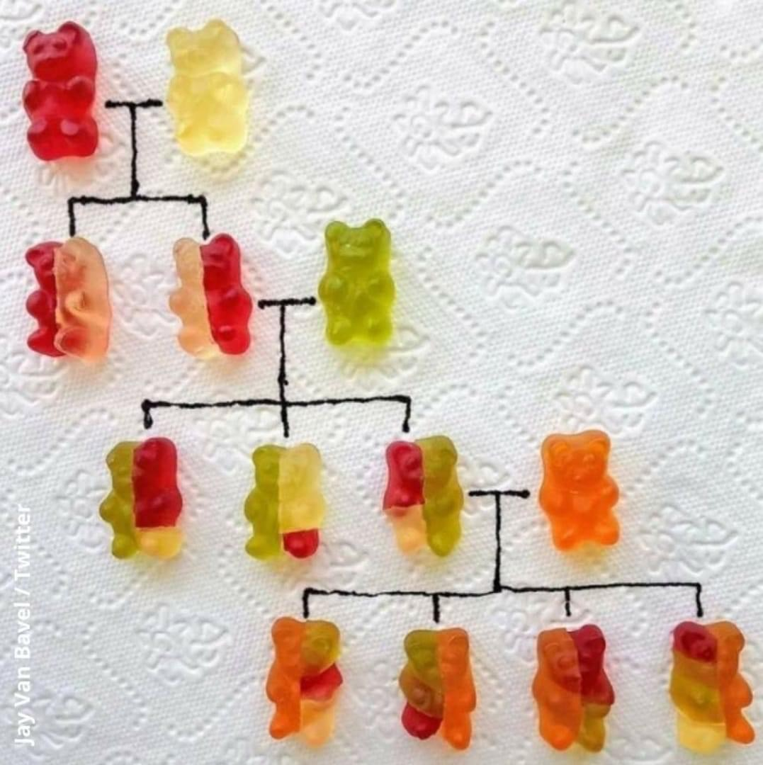
In the Moment – or The Long View?
Making sense of a life story with a network can mean:
Co-creating a story
Collecting ideas and perspectives, anecdotes, photos, reflections
Teasing out meanings over time
Finding the words
Writing it down

Slide 14
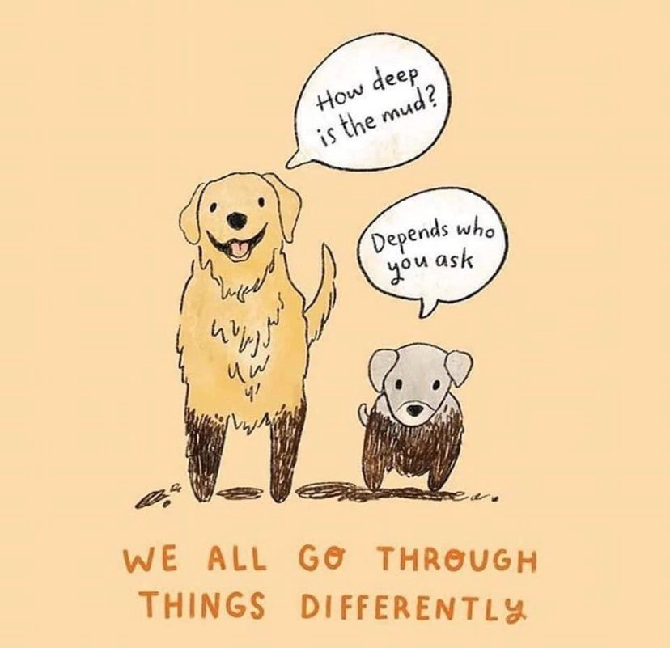
Going through

Slide 15

Whose story?
“even at a family meal we will all have a different perspective of what happened, and this is core for therapeutic life story work to ensure that different perspectives are sought and heard to really shape understanding and a coherent narrative to be formed”
Lemn Sissay

Slide 16

Pat Crittenden
‘Today’s parents are yesterday’s children, each as valuable as another, with the success of each generation inextricably tied to that of those who came before and those who will follow. Understanding this and acting with humility in the face of such immense complexity is the role professionals have assigned to themselves.’
Pat Crittenden: Raising Parents

Slide 17


Conflict is ok
Notes:
Reflections on accessing care records and supporting good recording (researchinpractice.org.uk)

Slide 18
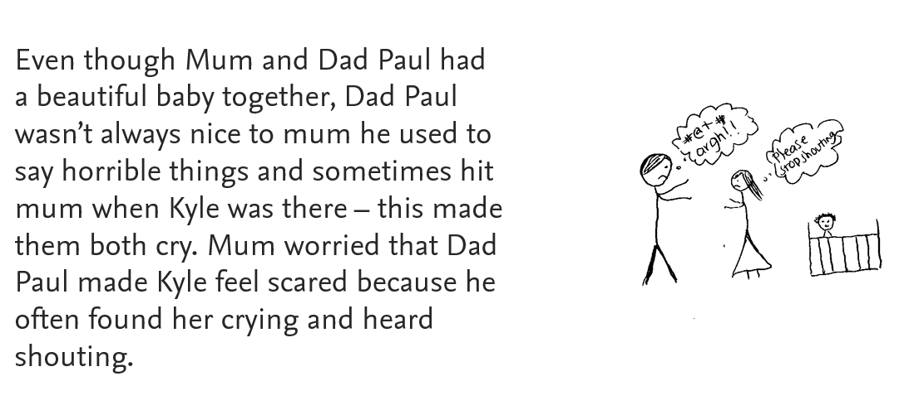
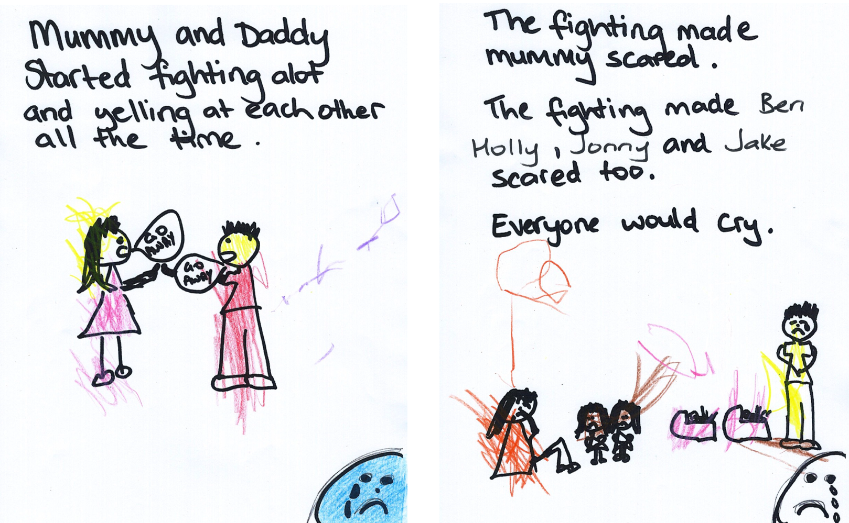
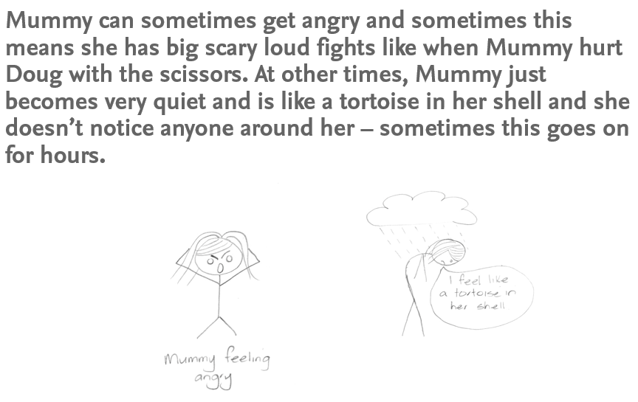
Words and Pictures

Slide 19

Sharing Stories
Jasmine is 15, and has been in care for 6 years
Lots of family time with mum and nan, but many barriers to staying over
Jasmine wants to live with mum
Meet with mum and Jasmine on their own, find the words, then bring together to tell her story
Shared words – even if different explanations

Slide 20

Telling Stories
Gavin is 16, his daughter Esme is 5 months, both are looked after children.
Gavin lived with Esme for 3 days, and since then has seen her twice. He does not think he can care for her and wants her to have a good family.
Gavin has very limited family support, but they have come together to share information, for both children.
Social worker is helping Gavin tell his story – for Esme, and for himself.

Slide 21

Unknown Stories
Ryan is 14, Poppy is 9, and they live with paternal grandparents.
They lived with his mum until Ryan was 10, when his mum died.
Family Support Worker brought together people who knew Ryan’s mum, to share their memories and fill in the gaps.

Slide 22
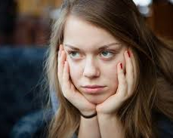
Untold Stories
Amy is 17, and lives in foster care. She is close to her boyfriend’s family, spending weekends, going on holiday. They are part of her network.
Amy has told everyone not to say anything about why she is in care – but her foster carer wants to check she has told the truth, in case she is found out.

Slide 23
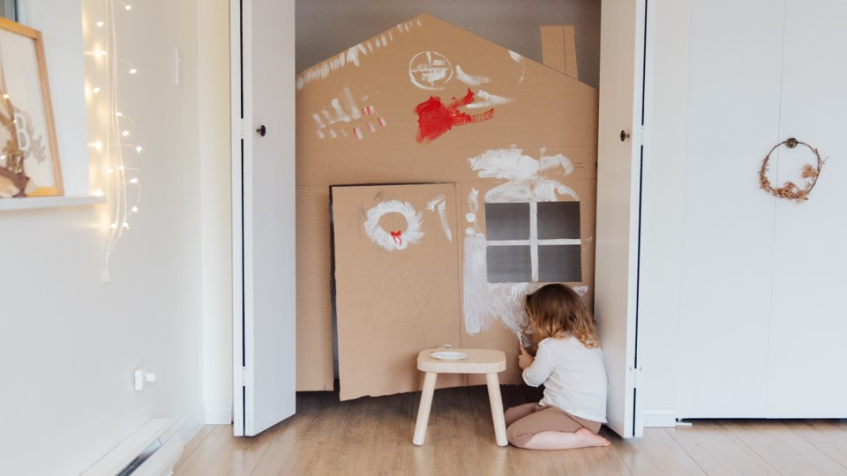
Think process not product

Slide 24


Group discussion
How do the different perspectives on storytelling help you think about the whole family network contributing to a child or young person’s life story?

Slide 25
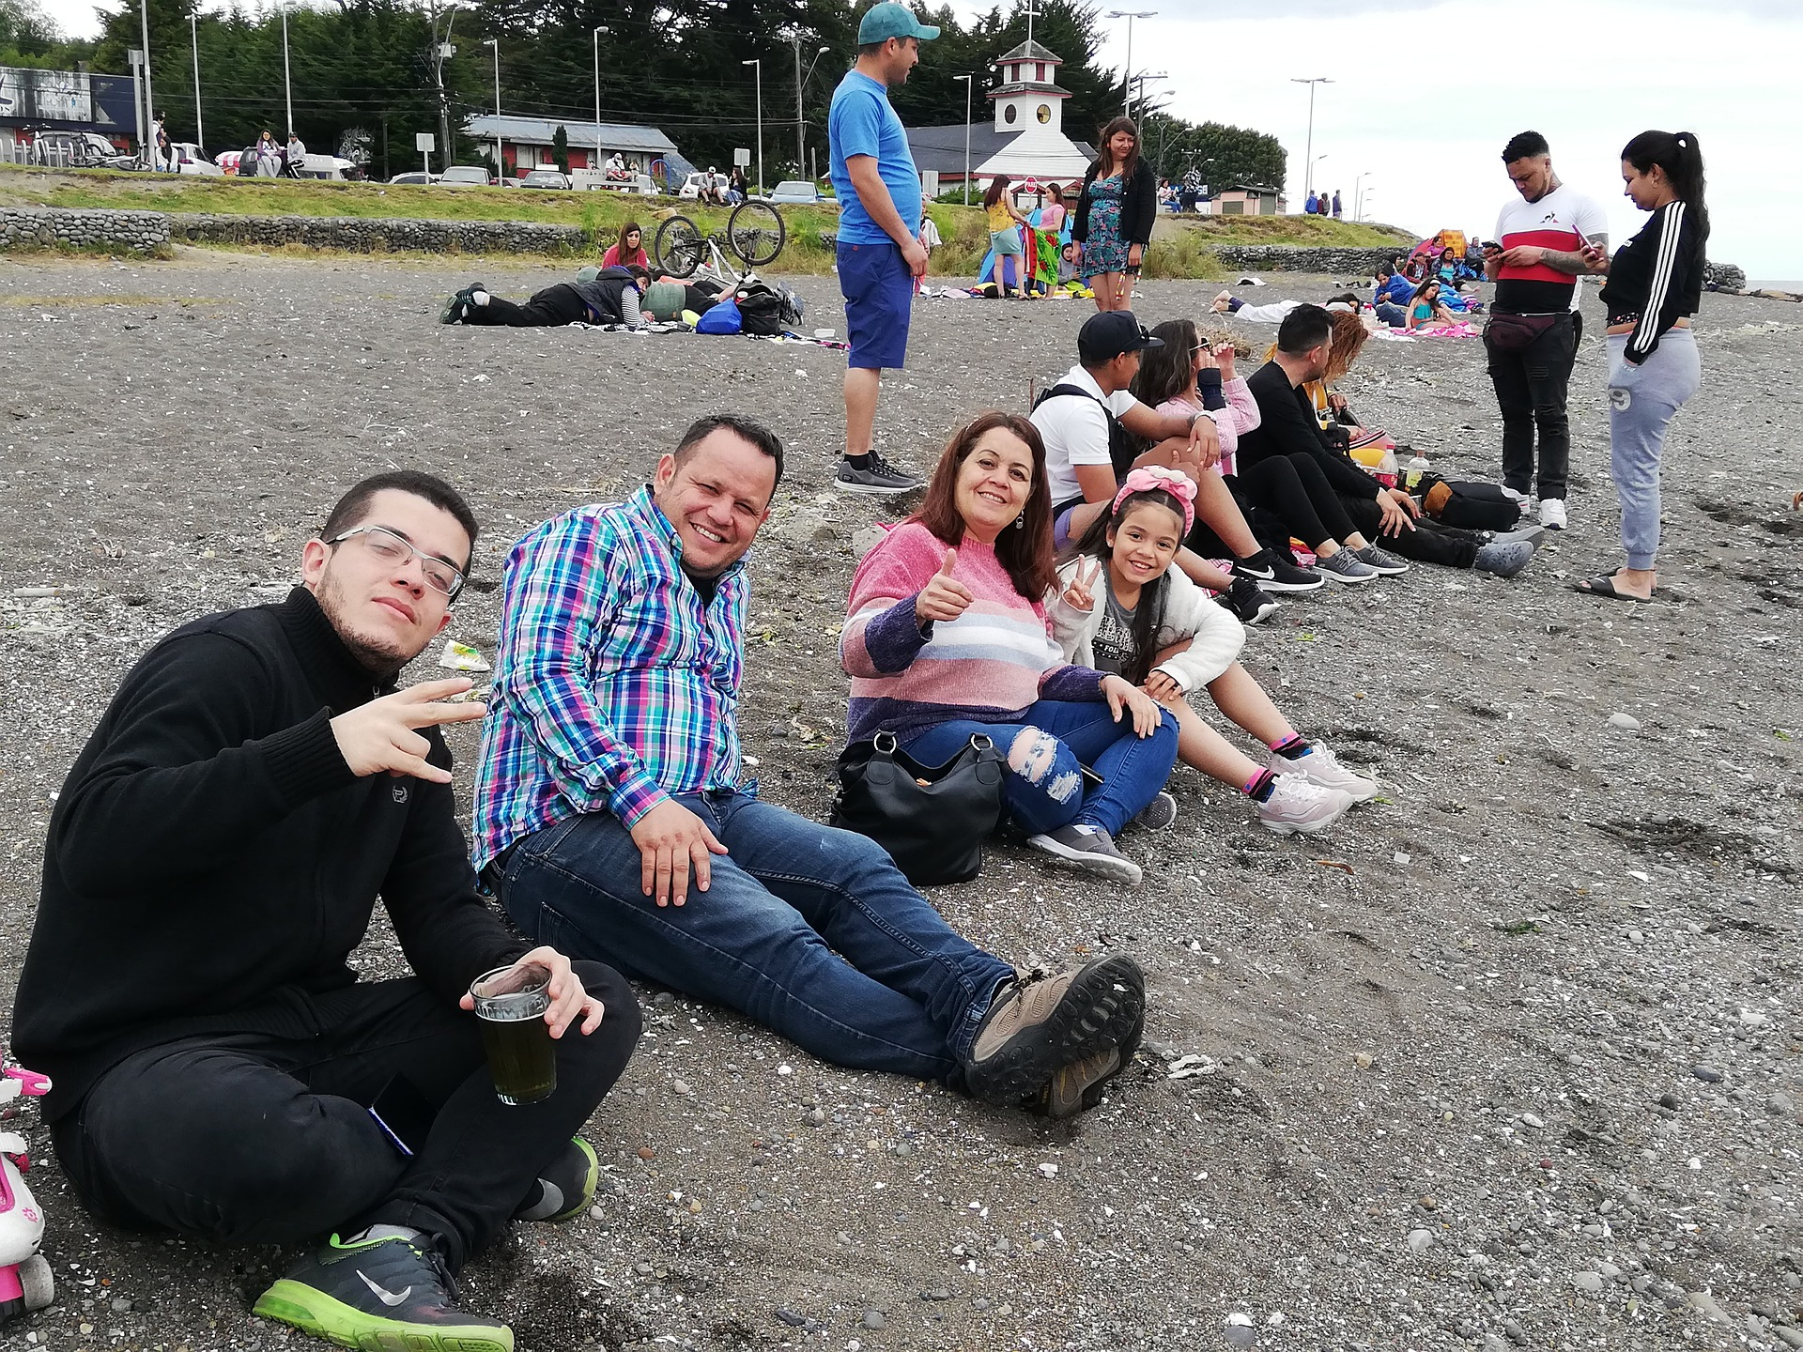
Life Story Work is everyone’s responsibility

Slide 26

Questions?

Slide 27

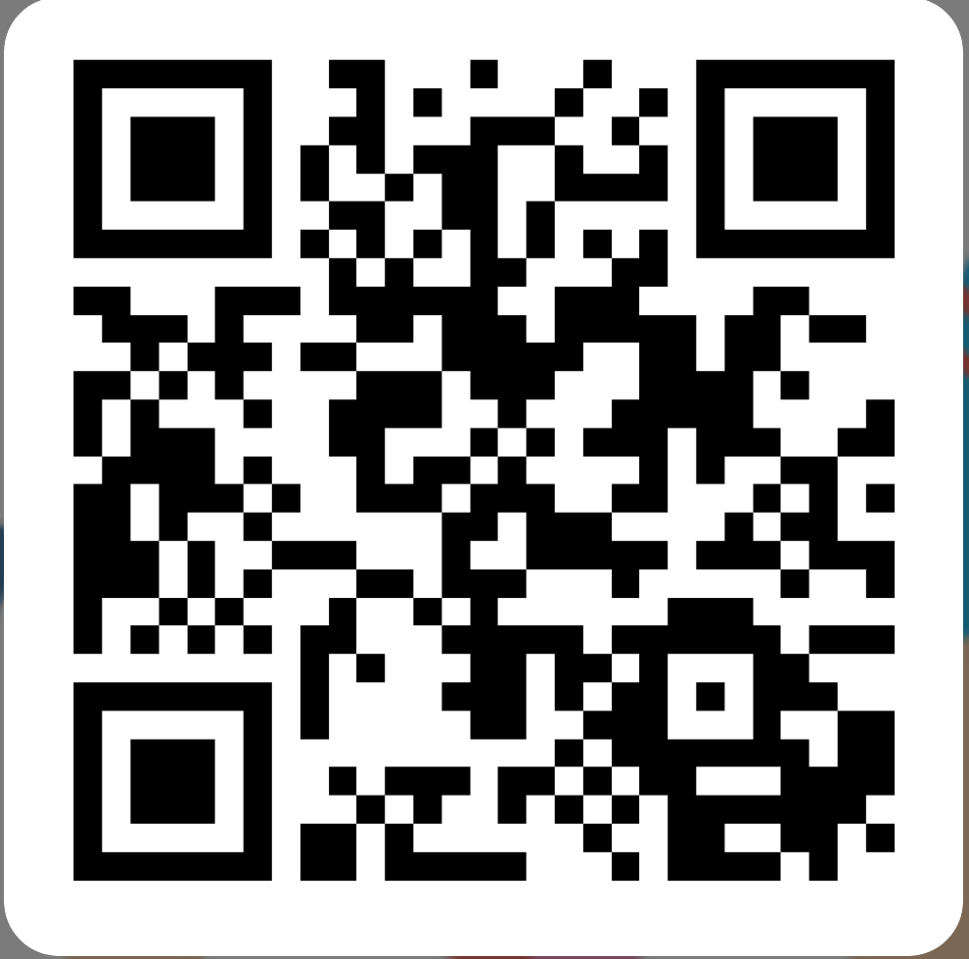
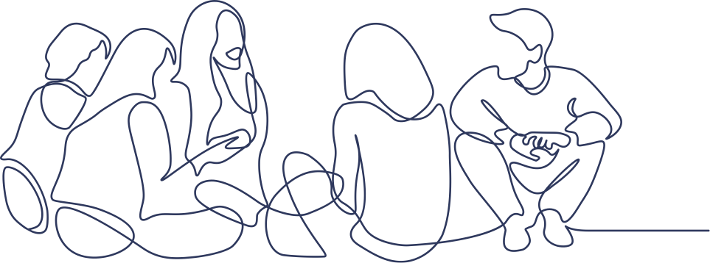
Please let us know what you think
https://forms.office.com/e/nFDzqZWk4i
Notes:
Presenters, please copy this link into the chat to request feedback:
https://forms.office.com/e/nFDzqZWk4i

